Slide 1
Leaf sorting game

Slide 2

Mango

Slide 3

Guava

Slide 4
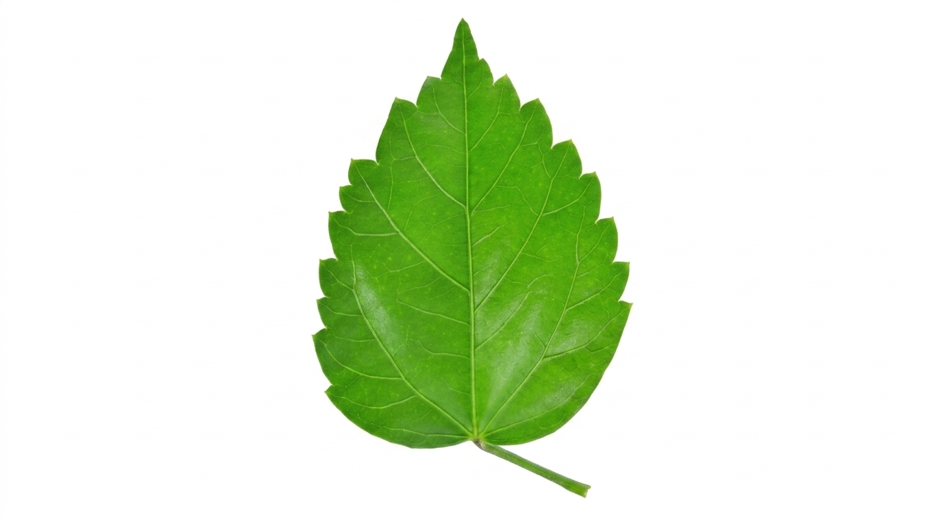
Hibiscus

Slide 5
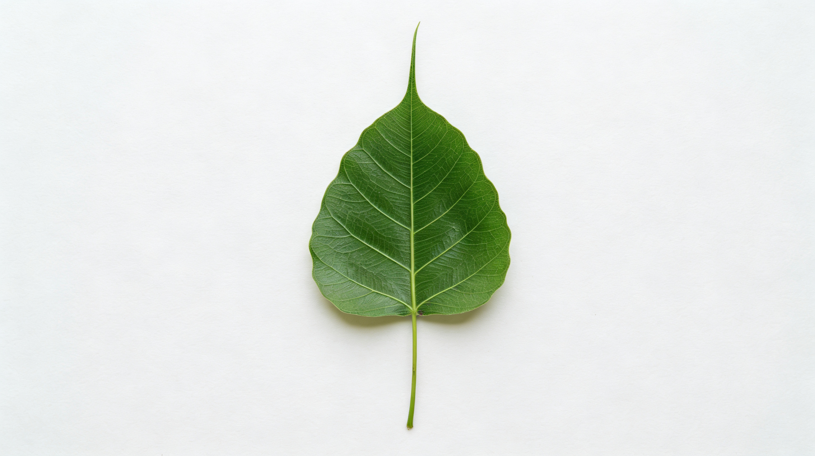
Peepal

Slide 6
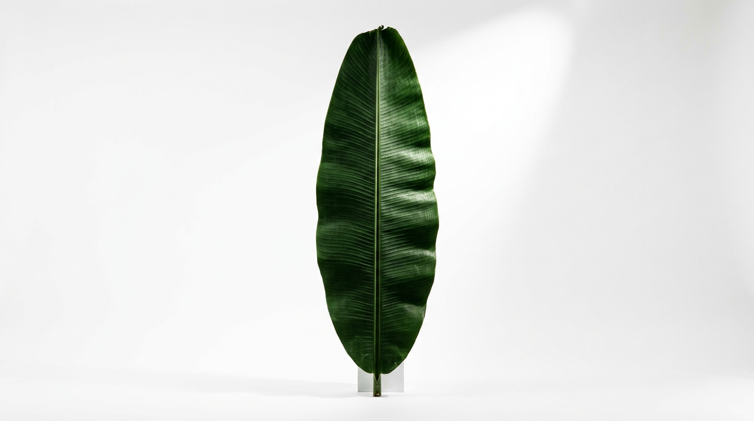
Banana

Slide 7

Papaya

Slide 8
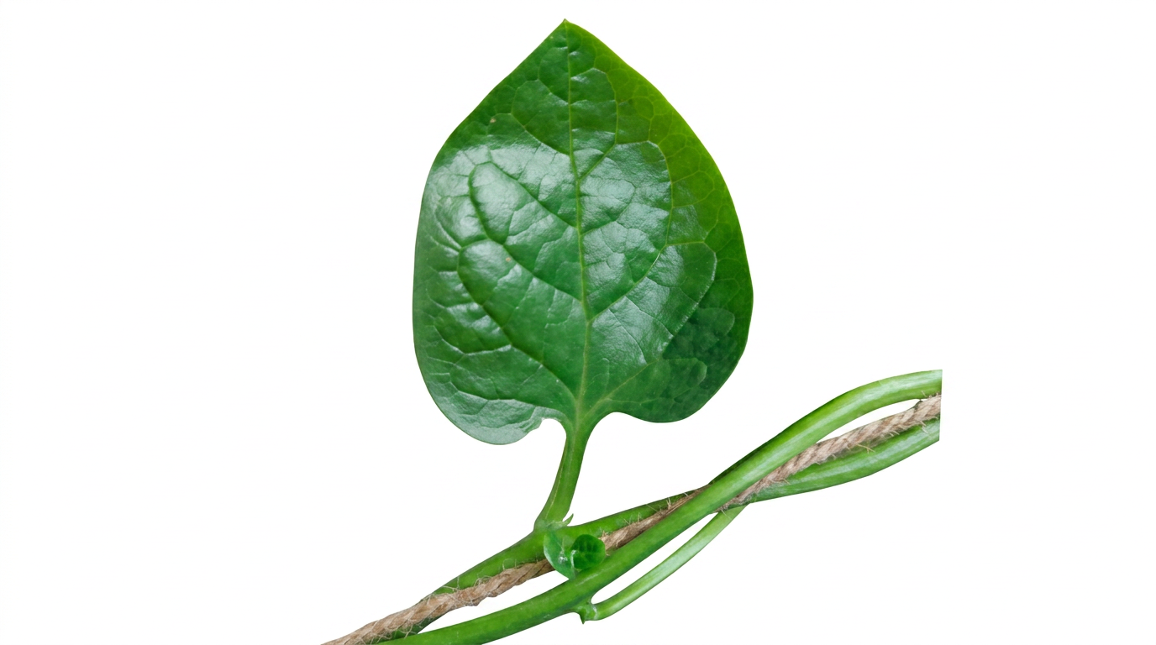
Malabar spinach

Slide 9
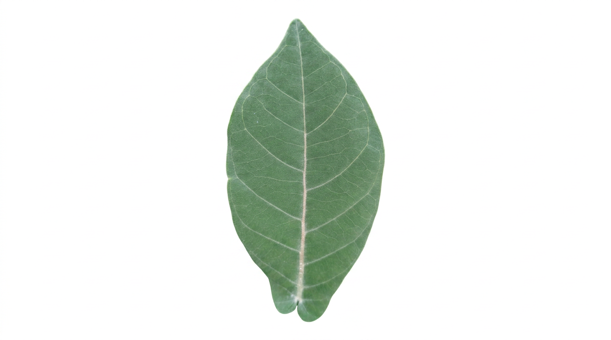
Calotropis

Slide 10
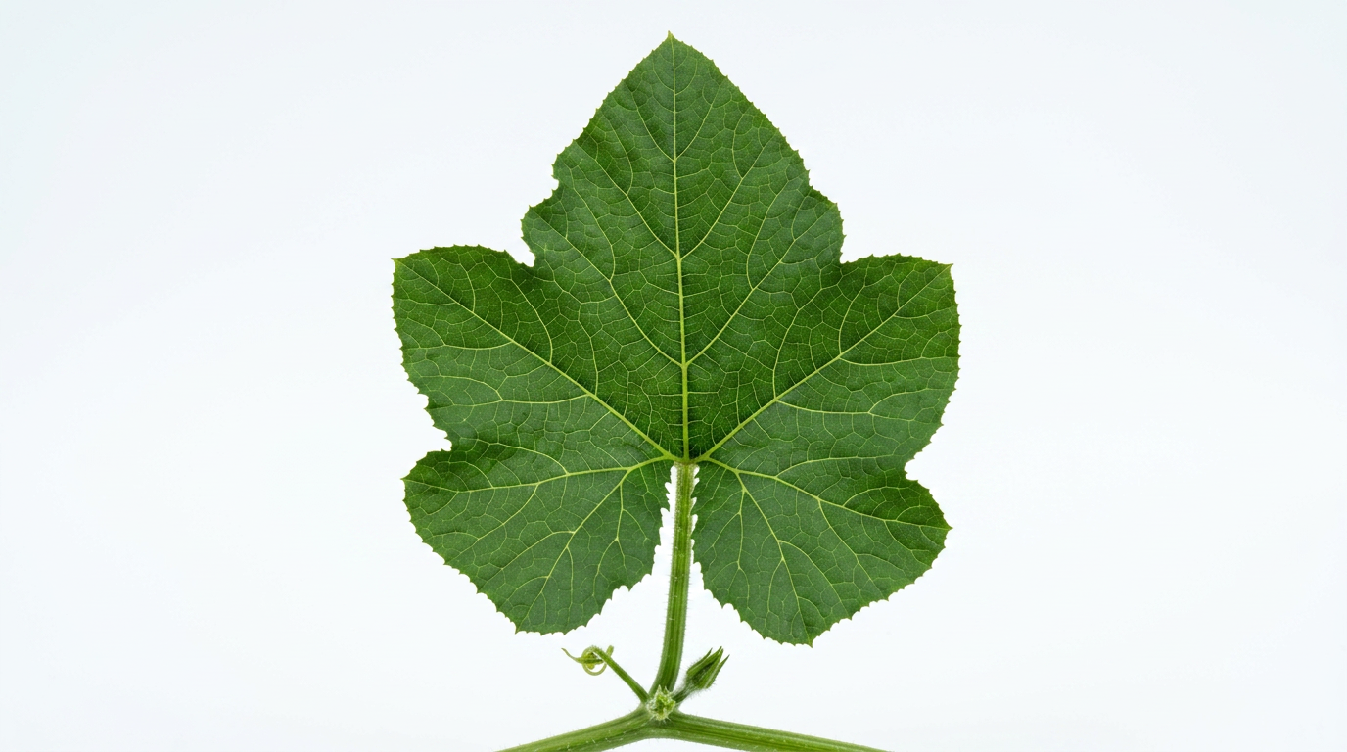
Pumpkin

Slide 11

Cotton

